Slide 1
we begin by defining a variable…
macro "Batch Split"{
format = ".tif";
...
}

Slide 2
macro "Batch Split"{
format = ".tif";
directory = getDirectory("Choose input files");
...
}

Slide 3
macro "Batch Split"{
format = ".tif";
directory = getDirectory("Choose input files");
print("Input: " + directory);
...
}

Slide 4
macro "Batch Split"{
format = ".tif";
directory = getDirectory("Choose input files");
print("Input: " + directory);
fileList = getFileList(directory);
...
}

Slide 5
macro "Batch Split"{
format = ".tif";
directory = getDirectory("Choose input files");
print("Input: " + directory);
fileList = getFileList(directory);
print(fileList.length + " files.");
...
}

Slide 6
macro "Batch Split"{
format = ".tif";
directory = getDirectory("Choose input files");
print("Input: " + directory);
fileList = getFileList(directory);
print(fileList.length + " files.");
outputDirectory = getDirectory("Choose output directory");
print("Output: " + outputDirectory);
setBatchMode(true);
...
}

Slide 7
macro "Batch Split"{
format = ".tif";
directory = getDirectory("Choose input files");
print("Input: " + directory);
fileList = getFileList(directory)
print(fileList.length + " files.");
outputDirectory = getDirectory("Choose output directory");
print("Output: " + outputDirectory);
setBatchMode(true);
...
setBatchMode(false);
}
Now we want to do something useful with the image files

Slide 8
macro "Batch Split"{
format = ".tif";
directory = getDirectory("Choose input files");
print("Input: " + directory);
fileList = getFileList(directory)
print(fileList.length + " files.");
outputDirectory = getDirectory("Choose output directory");
print("Output: " + outputDirectory);
setBatchMode(true);
for (i = 0; i < fileList.length; i++) {
...
}
setBatchMode(false);
}

Slide 9
macro "Batch Split"{
format = ".tif";
directory = getDirectory("Choose input files");
print("Input: " + directory);
fileList = getFileList(directory)
print(fileList.length + " files.");
outputDirectory = getDirectory("Choose output directory");
print("Output: " + outputDirectory);
setBatchMode(true);
for (i = 0; i < fileList.length; i++) {
file = directory + fileList[i];
...
}
setBatchMode(false);
}
We could now, for example, list all the file names

Slide 10
macro "Batch Split"{
format = ".tif";
directory = getDirectory("Choose input files");
print("Input: " + directory);
fileList = getFileList(directory)
print(fileList.length + " files.");
outputDirectory = getDirectory("Choose output directory");
print("Output: " + outputDirectory);
setBatchMode(true);
for (i = 0; i < fileList.length; i++) {
file = directory + fileList[i];
print("Current File: " + file);
...
}
setBatchMode(false);
}
However, it would be useful to check what the file is first…

Slide 11
macro "Batch Split"{
format = ".tif";
directory = getDirectory("Choose input files");
print("Input: " + directory);
fileList = getFileList(directory)
print(fileList.length + " files.");
outputDirectory = getDirectory("Choose output directory");
print("Output: " + outputDirectory);
setBatchMode(true);
for (i = 0; i < fileList.length; i++) {
file = directory + fileList[i];
if(endsWith(file, format)){
...
}
...
}
setBatchMode(false);
}

Slide 12
macro "Batch Split"{
format = ".tif";
directory = getDirectory("Choose input files");
print("Input: " + directory);
fileList = getFileList(directory)
print(fileList.length + " files.");
outputDirectory = getDirectory("Choose output directory");
print("Output: " + outputDirectory);
setBatchMode(true);
for (i = 0; i < fileList.length; i++) {
file = directory + fileList[i];
if(endsWith(file, format)){
...
}
...
}
setBatchMode(false);
}
But what’s this ‘if’ statement?

Slide 13
macro "Batch Split"{
format = ".tif";
directory = getDirectory("Choose input files");
print("Input: " + directory);
fileList = getFileList(directory)
print(fileList.length + " files.");
outputDirectory = getDirectory("Choose output directory");
print("Output: " + outputDirectory);
setBatchMode(true);
for (i = 0; i < fileList.length; i++) {
file = directory + fileList[i];
if(endsWith(file, format)){
print("\nFile " + file + " is a recognised format - processing.");
}
...
}
setBatchMode(false);
}

Slide 14
macro "Batch Split"{
format = ".tif";
directory = getDirectory("Choose input files");
print("Input: " + directory);
fileList = getFileList(directory)
print(fileList.length + " files.");
outputDirectory = getDirectory("Choose output directory");
print("Output: " + outputDirectory);
setBatchMode(true);
for (i = 0; i < fileList.length; i++) {
file = directory + fileList[i];
if(endsWith(file, format)){
print("\nFile " + file + " is a recognised format - processing.");
} else {
print("\nFile " + file + " is not a recognised format - skipping.");
}
}
setBatchMode(false);
}
I’m running out of space, so I’m just going to focus on the content of the ‘for’ loop now…
So let’s do something with these files…

Slide 15
Introducing The Run command
for (i = 0; i < fileList.length; i++) {
file = directory + fileList[i];
if(endsWith(file, format)){
print("\nFile " + file + " is a recognised format - processing.");
run("Bio-Formats Importer", "open=[" + file + "] color_mode=Default rois_import=[ROI manager] view=Hyperstack");
} else {
print("\nFile " + file + " is not a recognised format - skipping.");
}
}

Slide 16
Introducing The Run command
for (i = 0; i < fileList.length; i++) {
file = directory + fileList[i];
if(endsWith(file, format)){
print("\nFile " + file + " is a recognised format - processing.");
run("Bio-Formats Importer", "open=[" + file + "] color_mode=Default rois_import=[ROI manager] view=Hyperstack");
} else {
print("\nFile " + file + " is not a recognised format - skipping.");
}
}

Slide 17
for (i = 0; i < fileList.length; i++) {
file = directory + fileList[i];
if(endsWith(file, format)){
print("\nFile " + file + " is a recognised format - processing.");
run("Bio-Formats Importer", "open=[" + file + "] color_mode=Default rois_import=[ROI manager] view=Hyperstack");
getDimensions(width, height, sizeC, slices, frames);
} else {
print("\nFile " + file + " is not a recognised format - skipping.");
}
}
getDimensions(width, height, channels, slices, frames)
Returns the dimensions of the current image.

Slide 18
for (i = 0; i < fileList.length; i++) {
file = directory + fileList[i];
if(endsWith(file, format)){
print("\nFile " + file + " is a recognised format - processing.");
run("Bio-Formats Importer", "open=[" + file + "] color_mode=Default rois_import=[ROI manager] view=Hyperstack");
getDimensions(width, height, sizeC, slices, frames);
print("Number of channels: " + sizeC);
} else {
print("\nFile " + file + " is not a recognised format - skipping.");
}
}

Slide 19
for (i = 0; i < fileList.length; i++) {
file = directory + fileList[i];
if(endsWith(file, format)){
print("\nFile " + file + " is a recognised format - processing.");
run("Bio-Formats Importer", "open=[" + file + "] color_mode=Default rois_import=[ROI manager] view=Hyperstack");
getDimensions(width, height, sizeC, slices, frames);
print("Number of channels: " + sizeC);
if(sizeC > 1){
run("Split Channels");
}
} else {
print("\nFile " + file + " is not a recognised format - skipping.");
}
}
Why don’t we just run the split channels command without the IF statement?
Split Channels will return an error if there are less than two channels.
Another good example of error checking
Always assume the user is an idiot!

Slide 20
for (i = 0; i < fileList.length; i++) {
file = directory + fileList[i];
if(endsWith(file, format)){
print("\nFile " + file + " is a recognised format - processing.");
run("Bio-Formats Importer", "open=[" + file + "] color_mode=Default rois_import=[ROI manager] view=Hyperstack");
getDimensions(width, height, sizeC, slices, frames);
print("Number of channels: " + sizeC);
if(sizeC > 1){
run("Split Channels");
}
subDirs = newArray(sizeC);
} else {
print("\nFile " + file + " is not a recognised format - skipping.");
}
}
Create a list that will contain sub-directories

Slide 21
for (i = 0; i < fileList.length; i++) {
file = directory + fileList[i];
if(endsWith(file, format)){
print("\nFile " + file + " is a recognised format - processing.");
run("Bio-Formats Importer", "open=[" + file + "] color_mode=Default rois_import=[ROI manager] view=Hyperstack");
getDimensions(width, height, sizeC, slices, frames);
print("Number of channels: " + sizeC);
if(sizeC > 1){
run("Split Channels");
}
subDirs = newArray(sizeC);
for(c = 0; c < sizeC; c++){
}
} else {
print("\nFile " + file + " is not a recognised format - skipping.");
}
}
Iterate over each of the channels

Slide 22
for (i = 0; i < fileList.length; i++) {
file = directory + fileList[i];
if(endsWith(file, format)){
print("\nFile " + file + " is a recognised format - processing.");
run("Bio-Formats Importer", "open=[" + file + "] color_mode=Default rois_import=[ROI manager] view=Hyperstack");
getDimensions(width, height, sizeC, slices, frames);
print("Number of channels: " + sizeC);
if(sizeC > 1){
run("Split Channels");
}
subDirs = newArray(sizeC);
for(c = 0; c < sizeC; c++){
subDirs[c] = outputDirectory + "C_" + (c+ 1);
}
} else {
print("\nFile " + file + " is not a recognised format - skipping.");
}
}
Construct sub-directory names based on output directory and channel number
Still need to create directories on file system

Slide 23
for (i = 0; i < fileList.length; i++) {
file = directory + fileList[i];
if(endsWith(file, format)){
print("\nFile " + file + " is a recognised format - processing.");
run("Bio-Formats Importer", "open=[" + file + "] color_mode=Default rois_import=[ROI manager] view=Hyperstack");
getDimensions(width, height, sizeC, slices, frames);
print("Number of channels: " + sizeC);
if(sizeC > 1){
run("Split Channels");
}
subDirs = newArray(sizeC);
for(c = 0; c < sizeC; c++){
subDirs[c] = outputDirectory + "C_" + (c + 1);
if(!File.exists(subDirs[c])){
}
}
}
}
Boolean complement operator
!false = true;
!true = false;
Check if directory exists

Slide 24
for (i = 0; i < fileList.length; i++) {
file = directory + fileList[i];
if(endsWith(file, format)){
print("\nFile " + file + " is a recognised format - processing.");
run("Bio-Formats Importer", "open=[" + file + "] color_mode=Default rois_import=[ROI manager] view=Hyperstack");
getDimensions(width, height, sizeC, slices, frames);
print("Number of channels: " + sizeC);
if(sizeC > 1){
run("Split Channels");
}
subDirs = newArray(sizeC);
for(c = 0; c < sizeC; c++){
subDirs[c] = outputDirectory + "C_" + (c + 1);
if(!File.exists(subDirs[c])){ File.makeDirectory(subDirs[c]);
}
}
}
}
Create the directories if they do not already exist

Slide 25
for (i = 0; i < fileList.length; i++) {
file = directory + fileList[i];
if(endsWith(file, format)){
print("\nFile " + file + " is a recognised format - processing.");
run("Bio-Formats Importer", "open=[" + file + "] color_mode=Default rois_import=[ROI manager] view=Hyperstack");
getDimensions(width, height, sizeC, slices, frames);
print("Number of channels: " + sizeC);
if(sizeC > 1){
run("Split Channels");
}
subDirs = newArray(sizeC);
for(c = 0; c < sizeC; c++){
subDirs[c] = outputDirectory + "C_" + (c + 1);
if(!File.exists(subDirs[c])){ File.makeDirectory(subDirs[c]);
}
}
titles = getList("image.titles");
}
}
Get the list of open images…

Slide 26
for (i = 0; i < fileList.length; i++) {
file = directory + fileList[i];
if(endsWith(file, format)){
print("\nFile " + file + " is a recognised format - processing.");
run("Bio-Formats Importer", "open=[" + file + "] color_mode=Default rois_import=[ROI manager] view=Hyperstack");
getDimensions(width, height, sizeC, slices, frames);
print("Number of channels: " + sizeC);
if(sizeC > 1){
run("Split Channels");
}
subDirs = newArray(sizeC);
for(c = 0; c < sizeC; c++){
subDirs[c] = outputDirectory + "C_" + (c + 1);
if(!File.exists(subDirs[c])){ File.makeDirectory(subDirs[c]);
}
}
titles = getList("image.titles");
for(j = 0; j < titles.length; j++){
}
}
}
…and iterate over the list.

Slide 27
for (i = 0; i < fileList.length; i++) {
file = directory + fileList[i];
if(endsWith(file, format)){
print("\nFile " + file + " is a recognised format - processing.");
run("Bio-Formats Importer", "open=[" + file + "] color_mode=Default rois_import=[ROI manager] view=Hyperstack");
getDimensions(width, height, sizeC, slices, frames);
print("Number of channels: " + sizeC);
if(sizeC > 1){
run("Split Channels");
}
subDirs = newArray(sizeC);
for(c = 0; c < sizeC; c++){
subDirs[c] = outputDirectory + "C_" + (c + 1);
if(!File.exists(subDirs[c])){ File.makeDirectory(subDirs[c]);
}
}
titles = getList("image.titles");
for(j = 0; j < titles.length; j++){
selectWindow(titles[j]);
}
}
}
We need to create a filename for the image before we save it

Slide 28
for (i = 0; i < fileList.length; i++) {
file = directory + fileList[i];
if(endsWith(file, format)){
print("\nFile " + file + " is a recognised format - processing.");
run("Bio-Formats Importer", "open=[" + file + "] color_mode=Default rois_import=[ROI manager] view=Hyperstack");
getDimensions(width, height, sizeC, slices, frames);
print("Number of channels: " + sizeC);
if(sizeC > 1){
run("Split Channels");
}
subDirs = newArray(sizeC);
for(c = 0; c < sizeC; c++){
subDirs[c] = outputDirectory + "C_" + (c + 1);
if(!File.exists(subDirs[c])){ File.makeDirectory(subDirs[c]);
}
}
titles = getList("image.titles");
for(j = 0; j < titles.length; j++){
selectWindow(titles[j]);
filename = subDirs[j] + File.separator + titles[j] + "_C" + (j + 1) + ".ome.tiff";
}
}
}
Now we just need to save the image…

Slide 29
for (i = 0; i < fileList.length; i++) {
file = directory + fileList[i];
if(endsWith(file, format)){
print("\nFile " + file + " is a recognised format - processing.");
run("Bio-Formats Importer", "open=[" + file + "] color_mode=Default rois_import=[ROI manager] view=Hyperstack");
getDimensions(width, height, sizeC, slices, frames);
print("Number of channels: " + sizeC);
if(sizeC > 1){
run("Split Channels");
}
subDirs = newArray(sizeC);
for(c = 0; c < sizeC; c++){
subDirs[c] = outputDirectory + "C_" + (c + 1);
if(!File.exists(subDirs[c])){ File.makeDirectory(subDirs[c]);
}
}
titles = getList("image.titles");
for(j = 0; j < titles.length; j++){
selectWindow(titles[j]);
filename = subDirs[j] + File.separator + titles[j] + "_C" + (j + 1) + ".ome.tiff";
print("Saving " + filename);
run("Bio-Formats Exporter",
"save=[" + filename + "]
use compression=Uncompressed");
}
}
}
…and close it

Slide 30
for (i = 0; i < fileList.length; i++) {
file = directory + fileList[i];
if(endsWith(file, format)){
print("\nFile " + file + " is a recognised format - processing.");
run("Bio-Formats Importer", "open=[" + file + "] color_mode=Default rois_import=[ROI manager] view=Hyperstack");
getDimensions(width, height, sizeC, slices, frames);
print("Number of channels: " + sizeC);
if(sizeC > 1){
run("Split Channels");
}
subDirs = newArray(sizeC);
for(c = 0; c < sizeC; c++){
subDirs[c] = outputDirectory + "C_" + (c + 1);
if(!File.exists(subDirs[c])){ File.makeDirectory(subDirs[c]);
}
}
titles = getList("image.titles");
for(j = 0; j < titles.length; j++){
selectWindow(titles[j]);
filename = subDirs[j] + File.separator + titles[j] + "_C" + (j + 1) + ".ome.tiff";
print("Saving " + filename);
run("Bio-Formats Exporter",
"save=[" + filename + "]
use compression=Uncompressed");
close();
}
}
}

Slide 31
// Dave Barry, Francis Crick Institute
// 2018.01.17 // david.barry@crick.ac.uk
// Converts all files in a directory to TIFF - there will be one TIFF file per channel per input file.
macro "Batch Split"{
format = ".tif";
directory = getDirectory("Choose input files");
print("Input: " + directory);
fileList = getFileList(directory);
print(fileList.length + " files.");
outputDirectory = getDirectory("Choose output directory");
print("Output: " + outputDirectory);
setBatchMode(true);
for (i=0; i<fileList.length; i++) {
file = directory + fileList[i];
if(endsWith(file, format)){
print("\nFile " + file + " is a recognised format - processing.");
run("Bio-Formats Importer", "open=[" + file + "] color_mode=Default rois_import=[ROI manager] view=Hyperstack");
getDimensions(width, height, sizeC, slices, frames);
print("Number of channels: " + sizeC);
if(sizeC > 1){
run("Split Channels");
}
subDirs = newArray(sizeC);
for(c=0; c<sizeC; c++){
subDirs[c] = outputDirectory + "C_" + (c + 1);
if(!File.exists(subDirs[c])){
File.makeDirectory(subDirs[c]);
}
}
titles = getList("image.titles");
for(j = 0; j < titles.length; j++){
selectWindow(titles[j]);
filename = subDirs[j] + File.separator + titles[j] + "_C" + (j + 1)
+ ".ome.tiff";
print("Saving " + filename);
run("Bio-Formats Exporter", "save=[" + filename + "]
use compression=Uncompressed");
close();
}
} else {
print("\nFile " + file + " is not a recognised format - skipping.");
}
}
print("\nFinished");
setBatchMode(false);
}

Slide 32

11 – Challenge time

Slide 33
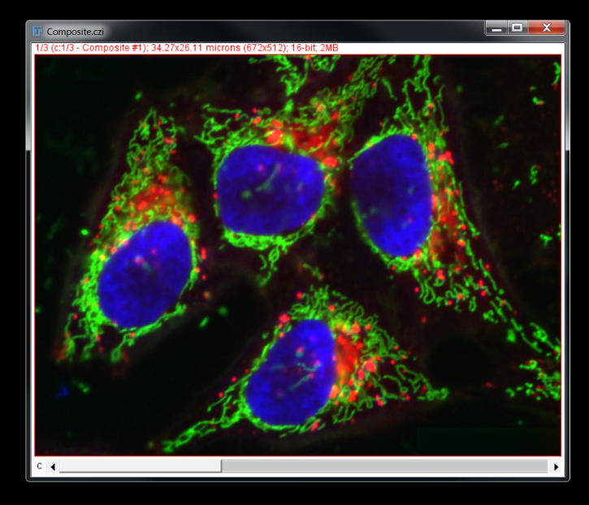
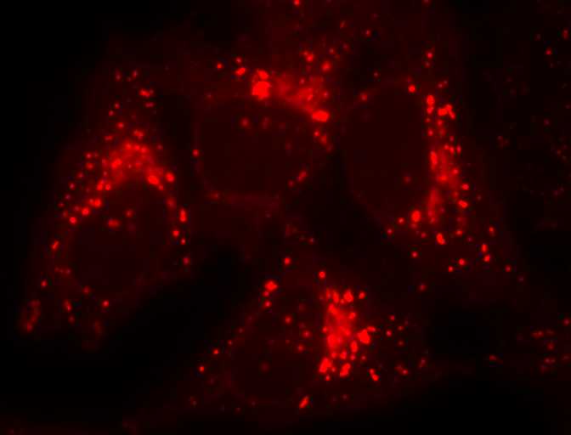
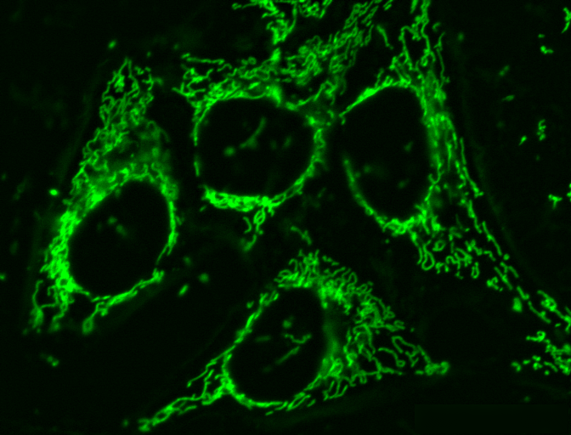
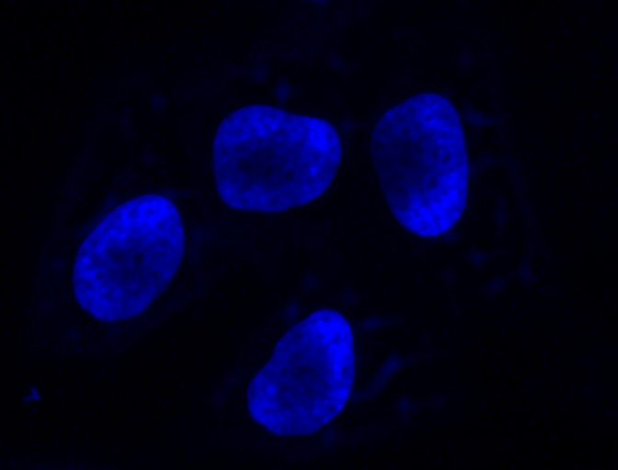
Challenge 1
Split all images into their constituent channels

Slide 34
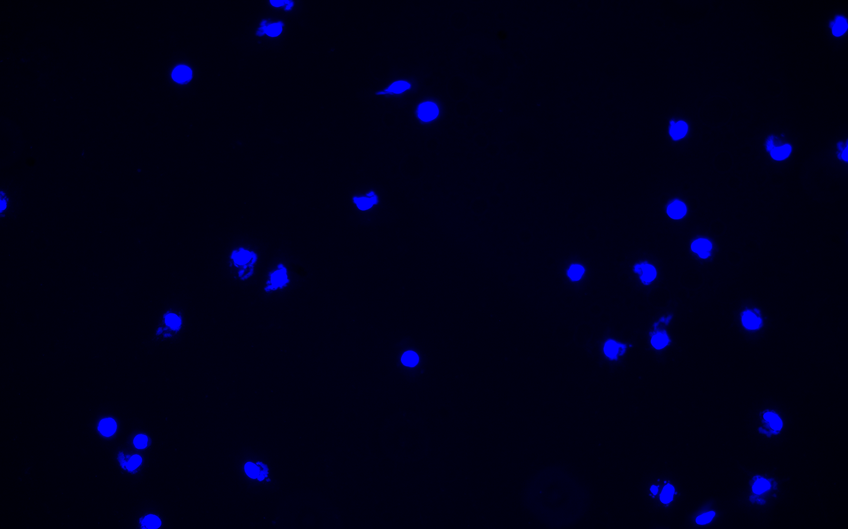
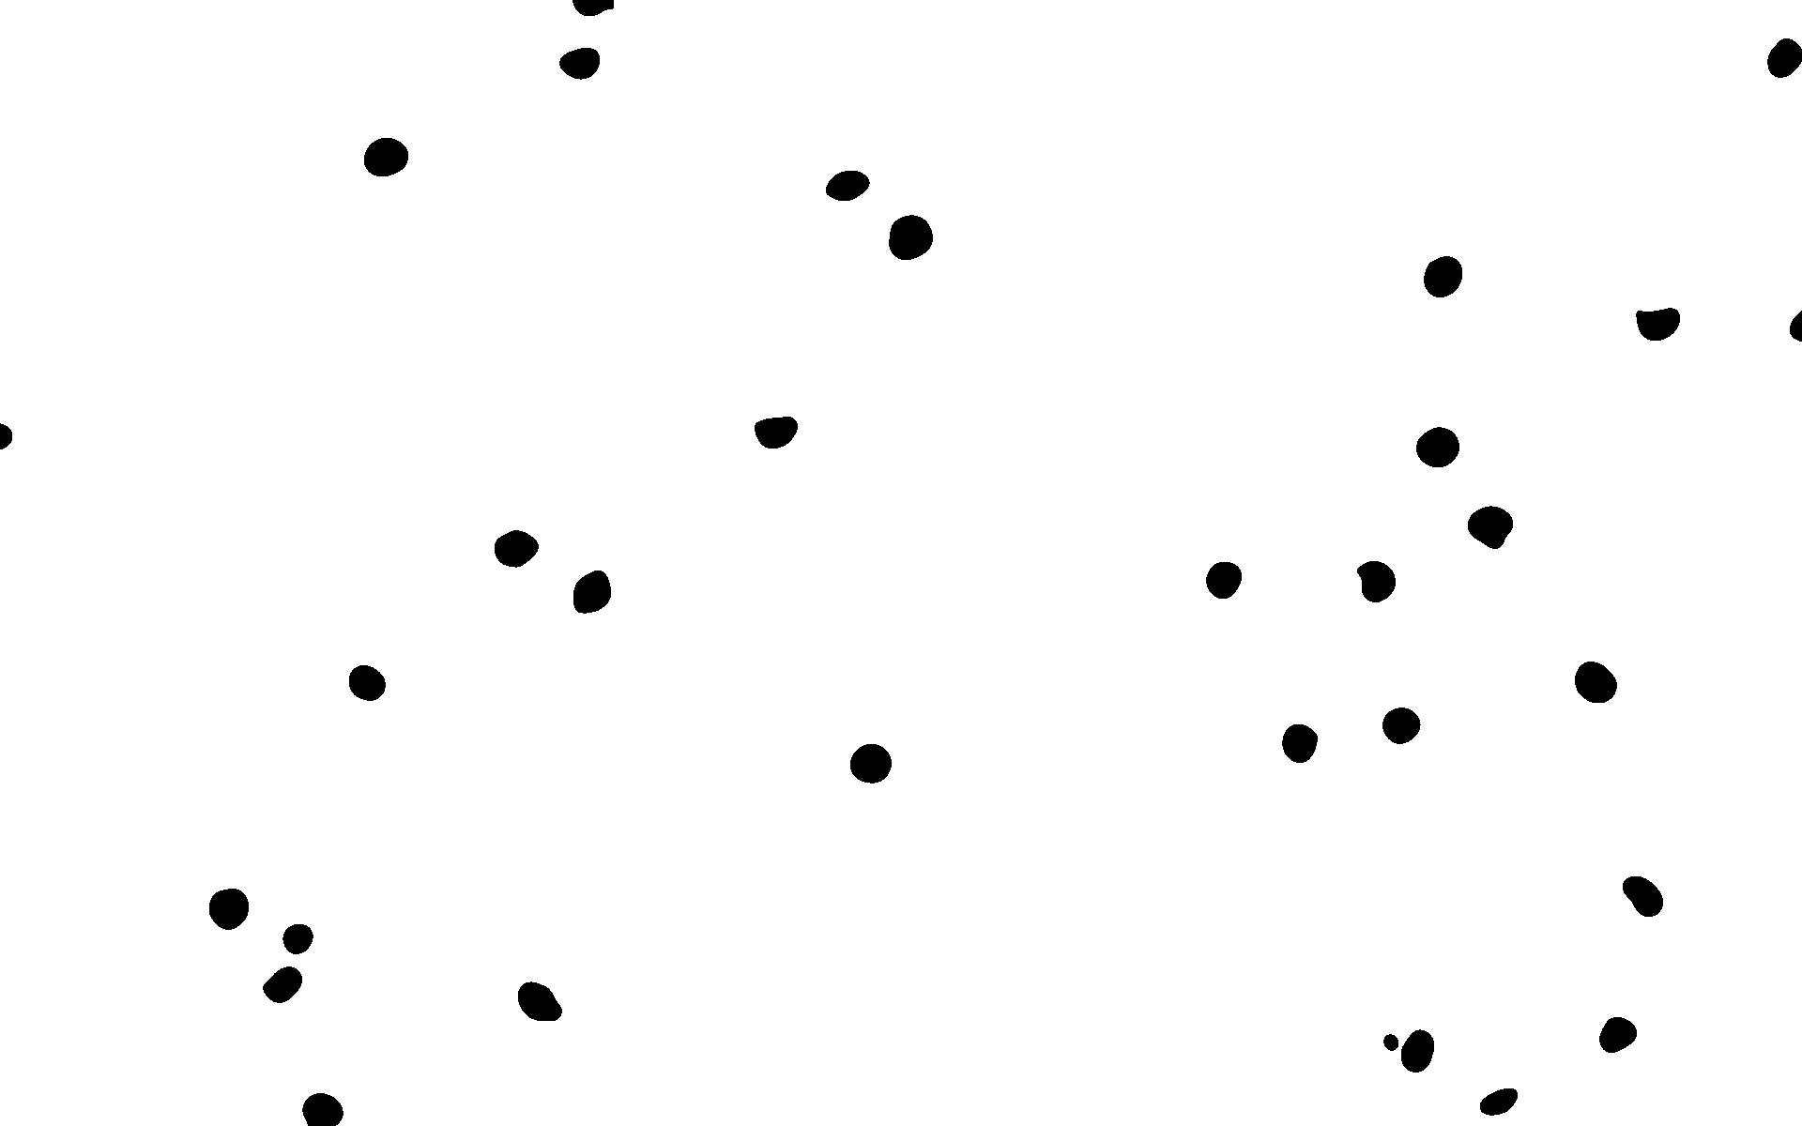
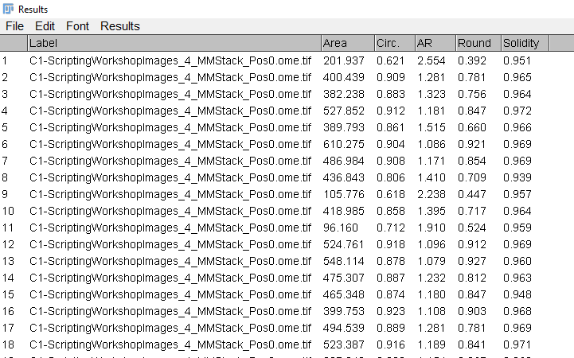
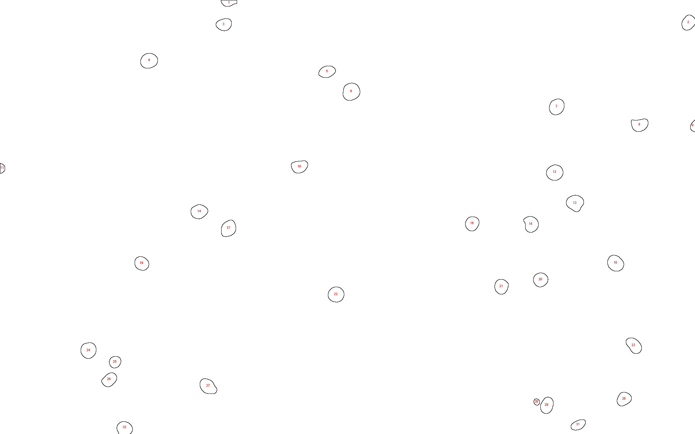
Challenge 2
Count the number of nuclei in each image

Slide 35
13 – requesting user input

Slide 36
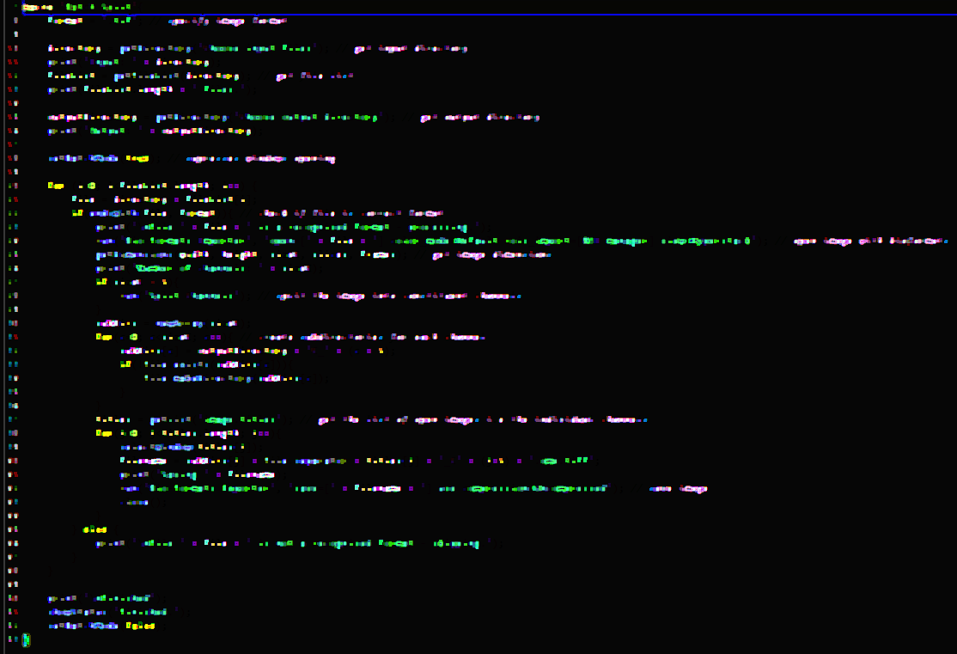
DEMO 13 – Creating Dialogs
Open Snippets/13_Creating_Dialogs.ijm
width

Slide 37
Challenge 3
Modify your code for Challenge 2 to make use of a user interface (dialog) to request input parameters.

Slide 38
And Finally…

Slide 39
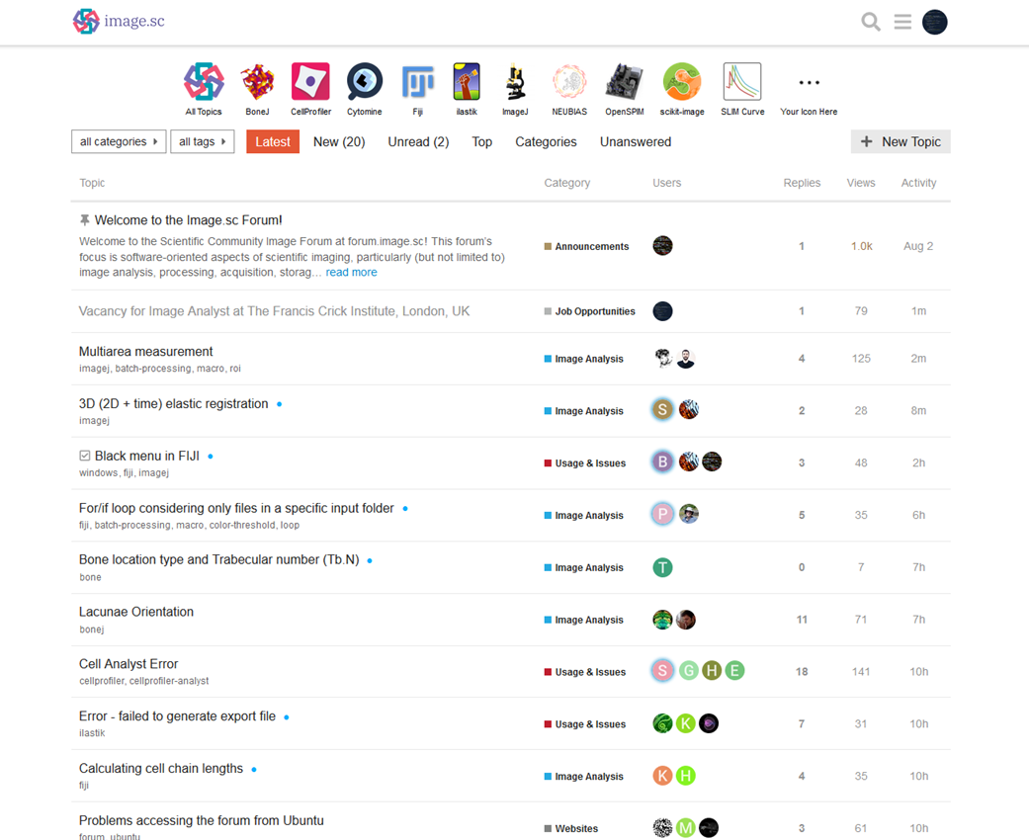

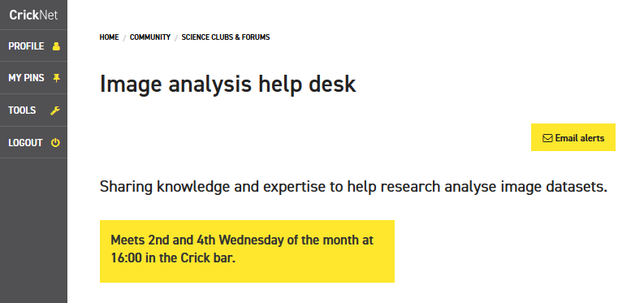


Thanks for sticking around
david.barry@crick.ac.uk
SW302

Slide 40
Useful references
https://doi.org/10.1371/journal.pcbi.1007433
https://doi.org/10.1371/journal.pcbi.1005871

